Slide 1
Non-Urban America & the Digital Divide Deep Fiber + New Business Models
Haywood County Broadband Committee
September 12, 2019
Stagg Newman
lsnewmanjr@yahoo.com
828-665-1531

Slide 2
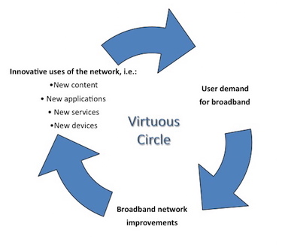
The Broadband Virtuous Cycle 100 M US. Homes with > 100 Mbps Internet Access in 2020 Non-Urban America Being Left Further Behind!!
Population Covered | Notional Cost Factor
00% – 90% | 1X-2X
90% - 99% | 2X-20X
99% - 100% | 20X – 200X
Telco copper and conventional cellular technology hitting limits; 5G will require 100 times more cell sites per square mile in rural America
Without deep fiber, rural America will be left further behind.
The economics of rural broadband are daunting – and require a fundamental rethinking across Technologies, Local Conditions, and Business Models.
Performance doubles Every 2 years in urban and suburban areas
Source: Stagg Newman, FCC Subadvisory Committee work

Slide 3
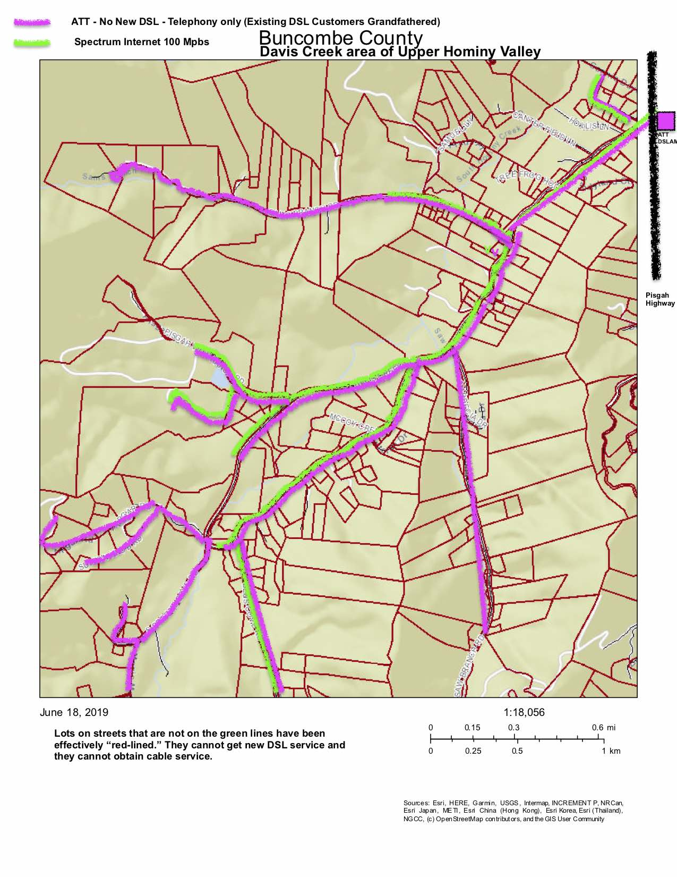
Davis Creek Road Area – Upper Hominy Valley Iconic example of the “Rural” Problem
Charter Spectrum provides 100 Mbps to only 2/3rds homes
ATT exiting market abandoning customers with no or SLOW DSL
Poor cellular coverage due to terrain

Slide 4
Capital Cost Distribution for Rural FTTH (1000-3000 Households, density 23 HHs/Km²)
The Technologies – Deep Fiber
Sine Qua Non – and it is a civil engineering problem
Insufficient architectures
Wide area wireless networks without deep fiber
DSL
Satellite except for most remote areas
Older cable networks
50% of cost is construction of outside plant to the curb
33% of cost is drop to the house
Both of these are dominated by labor costs
Source: Stagg Newman, FCC Subadvisory Committee work
Source: https://doi.org/10.1016/j.telpol.2016.04.002

Slide 5
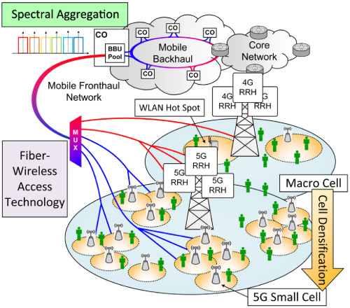

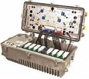


Future-proof networks Deep Fiber, 5G Wireless, Modern Cable
Future proof networks
Deep Fiber down almost all streets
Final drop by either
Fiber (fiber to the home)
Modern cable
Really high speed wireless
Robust Mobility
Cell site radius of ¼ mile or less
DEEP FIBER
DIGITAL FIBER
COAX
COAX
R-PHY Node
Source: John Chapman, Cisco. FCC Subadvisory Committee work

Slide 6
What the Local Communities Can Do Act now to “Bridge the Digital Divide”
Inventory
Friendly policies such as dig once, do once for all utilities
Partnerships including utilities
RfN for Overbuilds or Upgrades or orchestrate Buy-outs if incumbents will not commit to modernize
Migigate risks through demand commitment and aggregation and anchor contracts
Find Partners to create a Deep Fiber Fixed and Mobile Broadband Evolvable Infrastruture
Source: Stagg Newman, FCC Subadvisory Committee work

Slide 7
Summary
The “Broadband Gap” between rural and underserved areas and urban centers in American is widening rapidly. Costs to close the much larger gap have increased dramatically in the last decade.
Broadband for the vast majority of Americans is on a virtuous cycle with performance doubling every 18 to 36 months continuing to exacerbate the divide.
There is a rich set of technology options that can contribute to solutions but the heart of the problem is overcoming the cost of construction and operations.
New business models and new polices must enable diverse local/regional solutions – because Broadband is increasingly seen as a means for economic well being and as an investment in making rural areas desirable places to thrive.

